Slide 1

Group 4 Project 1
Green Portfolio Analysis
Ana Cano, Andrew Gopan, Nasir Farah, Ryan Judd
UNIVERSITY OF TORONTO

Slide 2

Table Of
Contents
01.
02.
03.
BACKGROUND
ANALYSIS
CONCLUSION
Motivation
Data Import
Approach
Performance
Risk
Rolling Statistics
Sharpe Ratios
Additional Python Library
Findings
Areas of improvement
GREEN PORTFOLIO ANALYSIS

Slide 3

Background
Motivation
Data Import
Analysis Approach
GREEN PORTFOLIO ANALYSIS

Slide 4
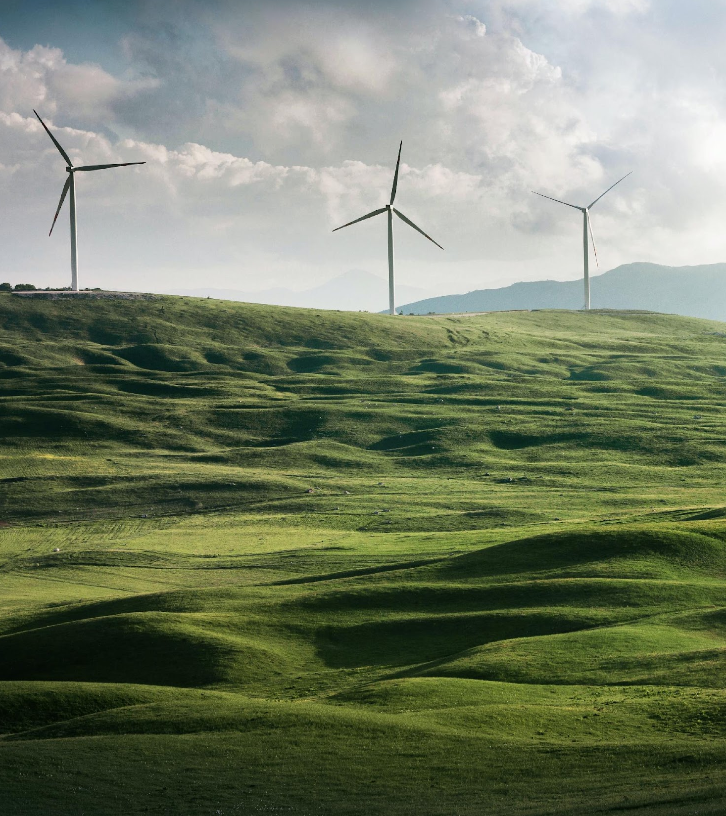
Motivation
Understand how “green” stocks are performing
Financial analysis of “Green” stocks against the S&P 500 and First Trust NASDAQ Clean Edge Index including performance, risk, and additional insights
GREEN PORTFOLIO ANALYSIS

Slide 5

Data Import
Historical financial data for the S&P 500 and First Trust NASDAQ Clean Edge Index came from Alpaca.
We chose the First Trust NASDAQ Clean Edge Index for its robust holdings of well-screened green stocks
We took 50 stocks from the Clean Edge Index and categorized them into 3 portfolios based on industry
GREEN PORTFOLIO ANALYSIS

Slide 6

Approach
We used one Jupyter Notebook for data cleaning and preparation, and another for data analysis
We decided to analyze the portfolios’ performance relative to the indices
GREEN PORTFOLIO ANALYSIS

Slide 7

Analysis
Performance
Risk
Rolling Statistics
Sharpe Ratios
Additional Analysis
GREEN PORTFOLIO ANALYSIS

Slide 8
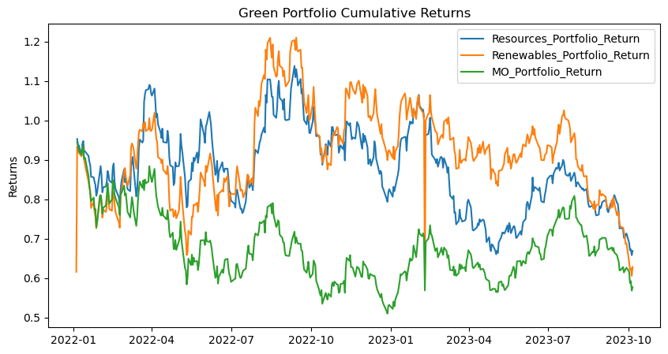
Performance
- There is a strong correlation between the three portfolios' interim daily average returns
- The green stocks' returns seem to respond similarly to the market events no matter what sector.
GREEN PORTFOLIO ANALYSIS

Slide 9
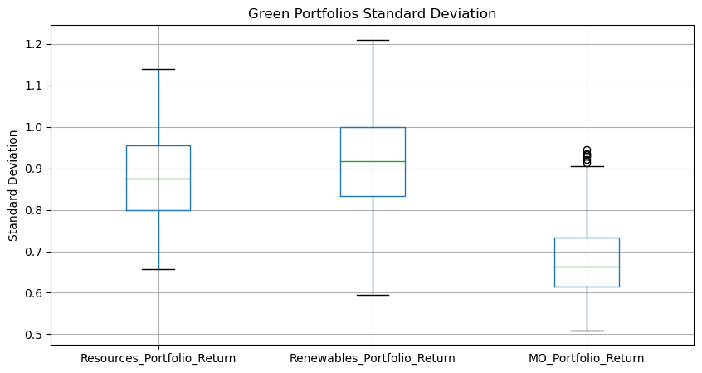
Green Standard Deviation
- By analyzing the volatility of the 3 portfolios, we conclude that the green stocks in the manufacturing portfolio are less volatile than the other two sectors.
- The green renewable energy sector has the highest volatility among the three sectors.
GREEN PORTFOLIO ANALYSIS

Slide 10
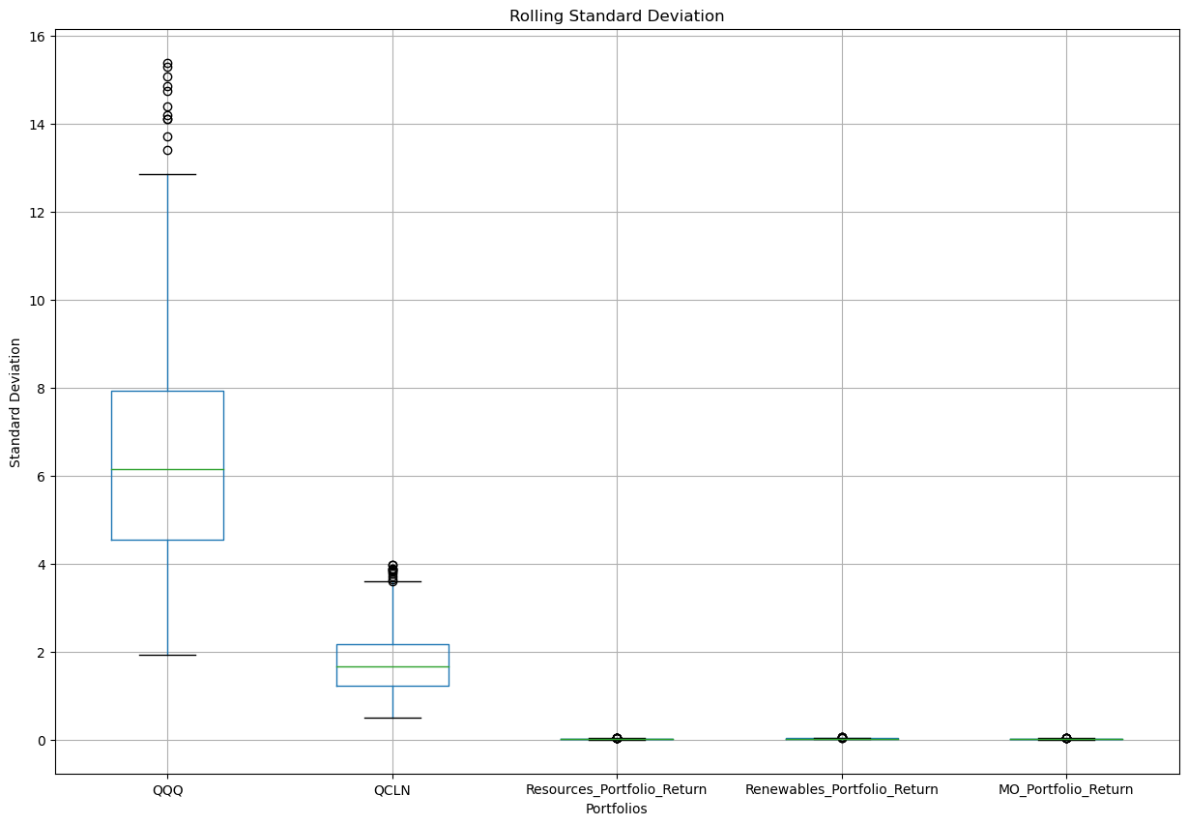
Rolling Standard Deviation
- This statistical measure provided useful information about the reliability of our portfolios.
-All three portfolios showed low deviation compared to the S&P and QCLN indexes.
-Also QCLN seems to be more reliable measured to S&P.
GREEN PORTFOLIO ANALYSIS

Slide 11
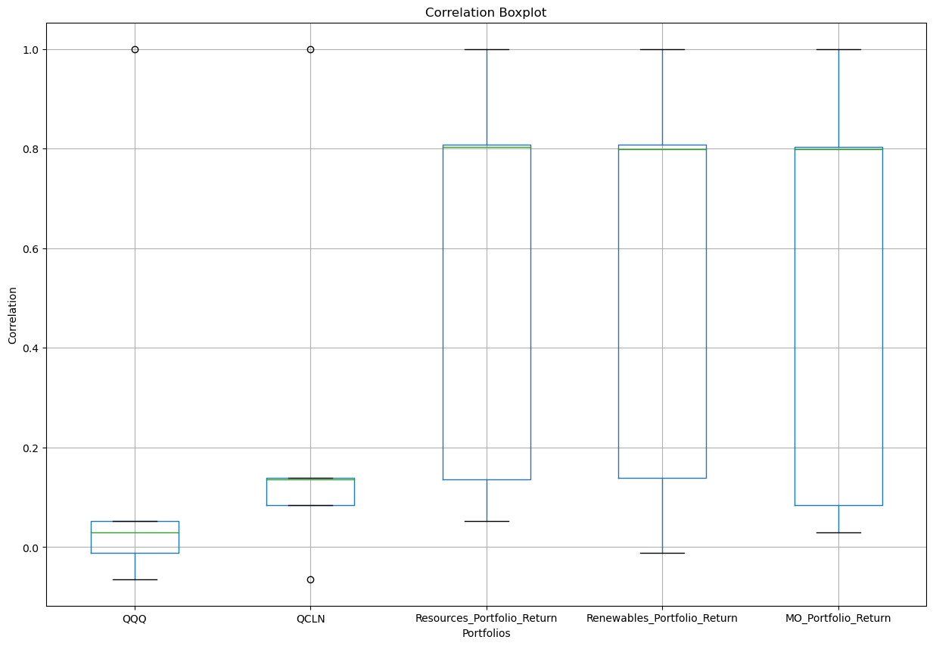
Correlation
- This indicator proves the relationship between each portfolios and the indexes.
- Our selections showed Good correlation between each other and a lower correlation between the indexes
GREEN PORTFOLIO ANALYSIS

Slide 12
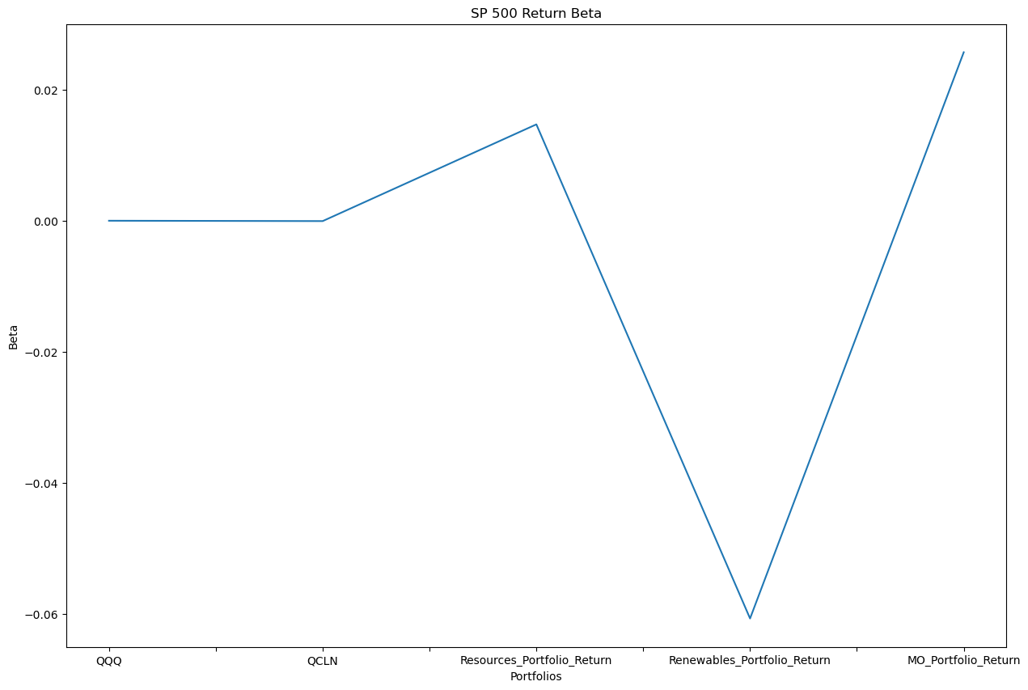
Beta
- Our chosen portfolios shows low Beta, which proves us they are less volatile to the markets performance.
- Interestingly our Renewable sector shows a negative beta, which informs us its opposite directional movement to the indexes.
GREEN PORTFOLIO ANALYSIS

Slide 13
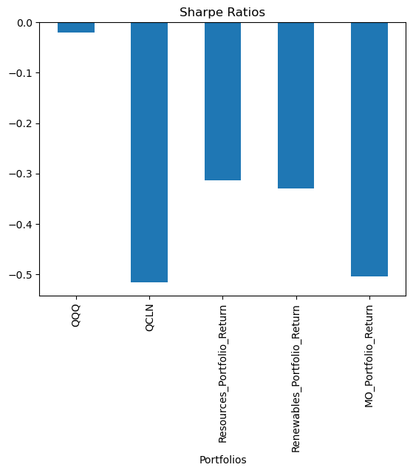
Sharpe Ratios
-The sharpe ratio evaluates risk and return together, to help choose an investment with the optimal risk.
-Generally, the higher the risk, the better the investment
-The Sharpe Ratio calculation formula is:
Avg. portfolio returns - returns of a risk free investment
Standard Deviation
-The best investment choice in this case is: QCLN
GREEN PORTFOLIO ANALYSIS

Slide 14
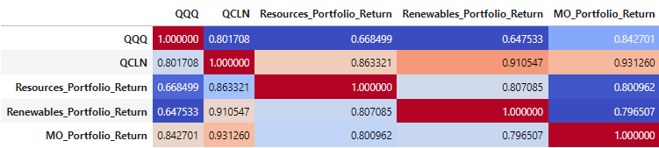
Correlation Additional Visual
Correlation matrix similar to heatmap but with greater range of colours
Strong correlation between renewables portfolio and QCLN as well as manufacturing portfolio and QCLN
GREEN PORTFOLIO ANALYSIS

Slide 15

Conclusion
FINDINGS
IMPROVEMENTS
Although some sectors are more volatile than others, the grouped green portfolios tend to move in the same direction.
The green stock in the manufacturing sector is more safe to invest in for the long term and less volatile.
Find a green portfolio with longer period of returns
Develop robust framework for categorizing 50 stocks into three portfolios
Spend additional time practicing collaborating in GitHub to avoid technical difficulties, rework, and improve version control
GREEN PORTFOLIO ANALYSIS

Slide 16
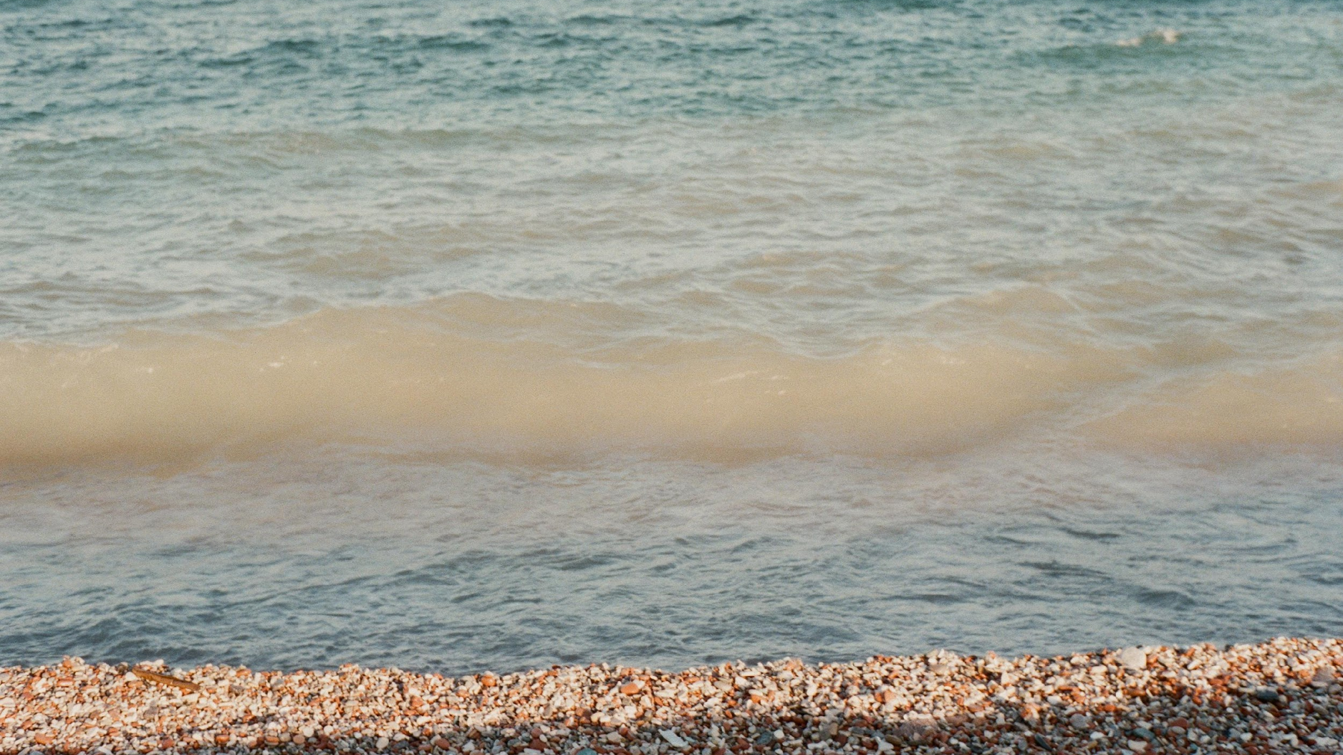
Questions & Answers
GREEN PORTFOLIO ANALYSIS

